Slide 1
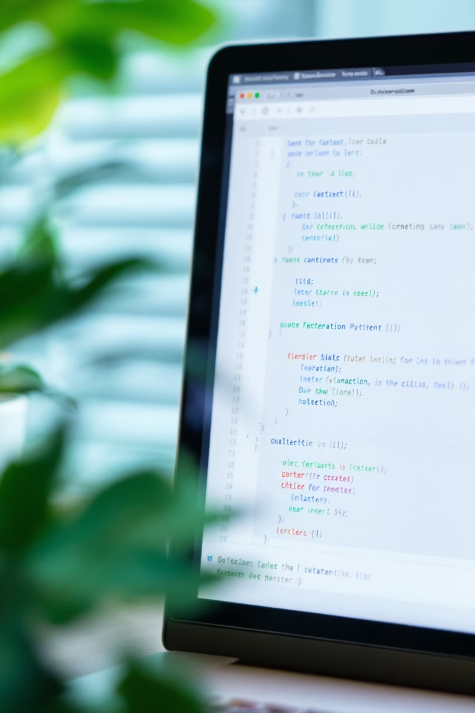

Introduction to Tkinter – Python's GUI Library
Building User-Friendly Desktop Applications
by Thet Naing Htun

Slide 2
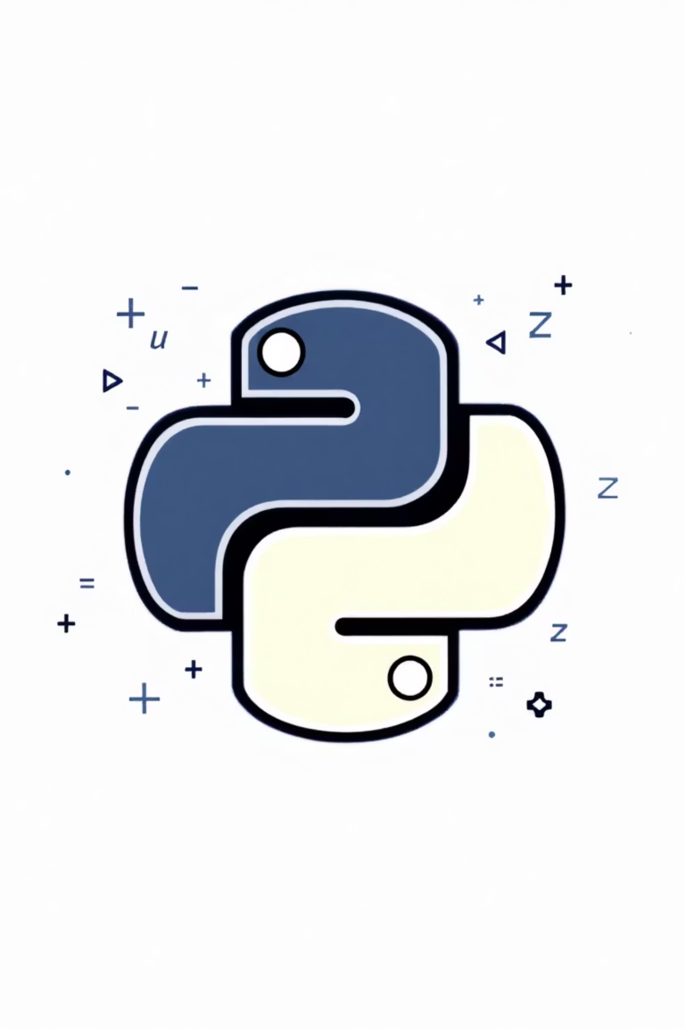
What is Tkinter?
Default GUI library for Python
Based on Tcl/Tk toolkit
Cross-platform compatibility
Lightweight and beginner-friendly

Slide 3

Why Choose Tkinter?
No additional installation
Beginner-friendly syntax
Rapid prototyping
Perfect for small-medium projects

Slide 4
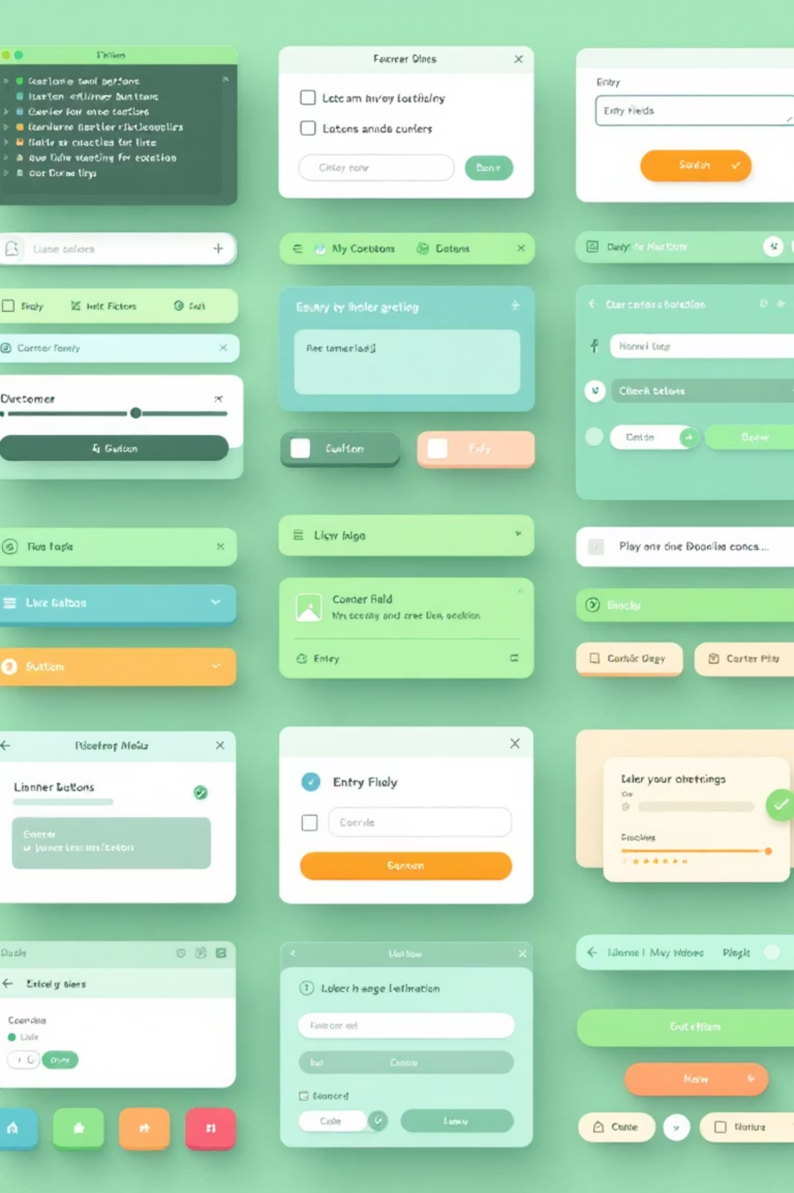


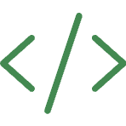
Key Features
Wide Range of Widgets
Customizable Appearance
Buttons, labels, text boxes, and more
Colors, fonts, and themes
Event-Driven Programming
Responsive user interactions

Slide 5
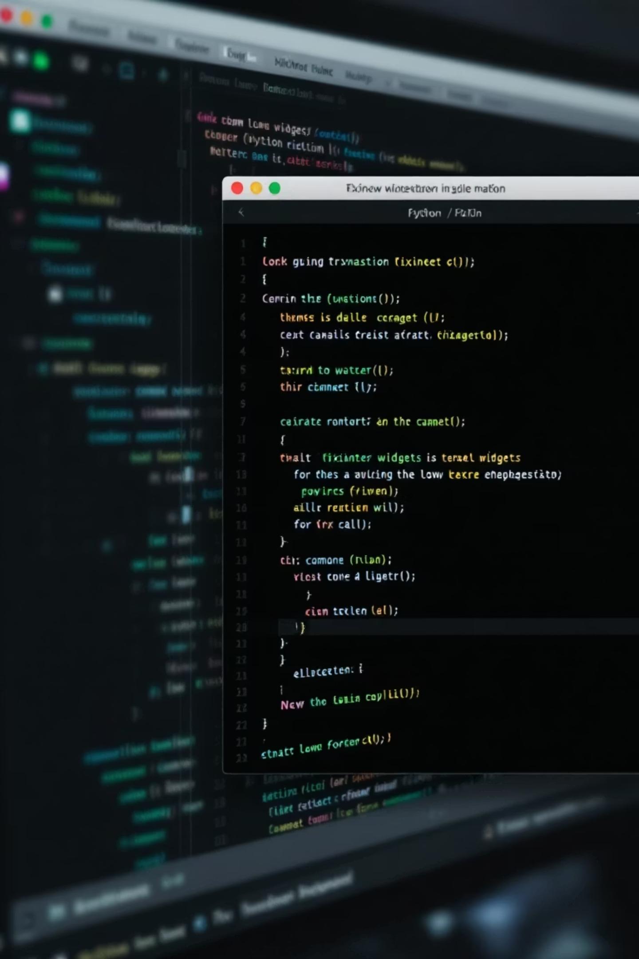
Basic Widgets
import tkinter as tk
root = tk.Tk()
btn = tk.Button(root, text="Click Me!")
btn.pack()
root.mainloop()

Slide 6
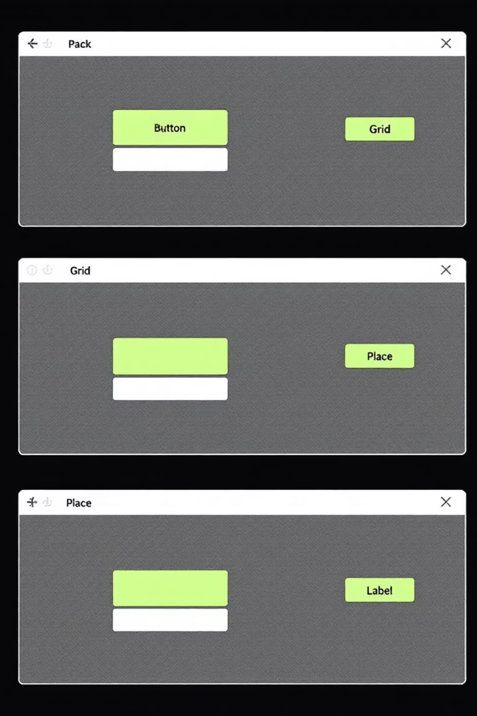

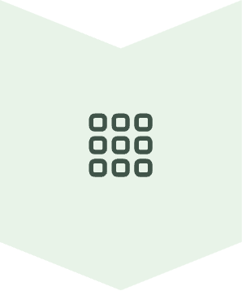

Layout Management
pack()
Simple vertical/horizontal stacking
grid()
Row/column-based layout
place()
Absolute positioning

Slide 7
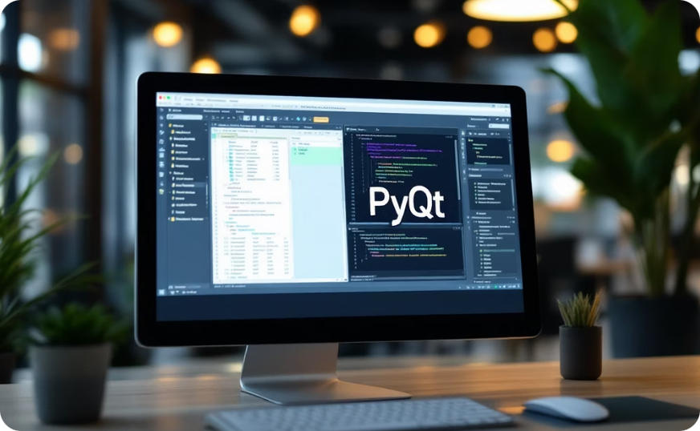
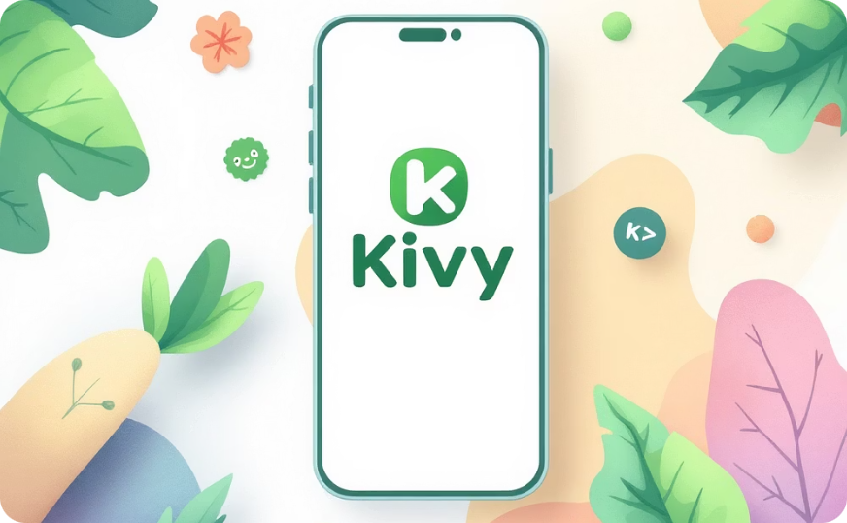
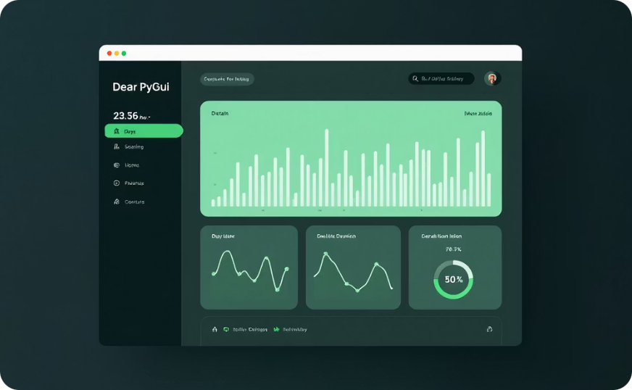
Alternatives to Tkinter
PyQt/PySide
More powerful, but complex
Kivy
For mobile/touch applications
Dear PyGui
Modern, GPU-accelerated

Slide 8

Start Building Today!
Easy to learn
Great for beginners
Cross-platform
No extra installation

